Slide 1

BOSTON NEIGHBOURHOOD ANALYSIS
-By Aashay, Apurv, Umesh and Ariv
Group 5

Slide 2

OVERVIEW
Business Problem - How have property valuations and characteristics evolved in different Boston neighborhoods over recent years?
How are crime, urban planning and sustainability statistics distributed in different Boston neighborhoods?
Importance: Real estate analytics holds a pivotal role in guiding decision-making processes, urban planning initiatives, and sustainability endeavors. Our project seeks to provide invaluable insights for stakeholders in the real estate industry, policymakers, and advocates for sustainable practices.
Target Audience:
Real Estate Professionals: Our findings are tailored to benefit professionals in the real estate sector.
Policymakers: The insights support urban planning and development strategies.
Individuals looking to buy or rent properties in Boston.
Companies or franchises planning to open offices or outlets in Boston.
This is also for students who would like to reside in a neighborhood following on their liking and preferences.
Our project distinguishes itself by incorporating a survey and employing an innovative approach using the Extra Trees Regressor. This technique harnesses binary trees to impute missing data values, thereby enhancing the robustness of our analysis.

Slide 3


DATA COLLECTION
Primary Dataset
Survey Conducted (63 rows, 12 columns)
Property Assessment Data 2000 - 2021 (Harvard Dataverse) (179392, 150)
Property Assessment (FY23) Dataset (ANALYZE BOSTON) (180627, 60)
Crime Incident Reports (2023) (ANALYZE BOSTON) (65545, 18)
Vision Zero Fatality Records (ANALYZE BOSTON) (4116, 11)
Blue Bike Stations (ANALYZE BOSTON) (466, 10 )
Secondary Datasets

Slide 4


DATA PRE-PROCESSING
DATA FORMATTING
DATA PROFILING
DATA CLEANING
Unit level of analysis – Individual Properties and neighborhoods
Structured Data – All datasets
Unstructured Data - None
Understanding the data
Imputation of missing values using
ExtraTreesRegressor

Slide 5
DATA FORMATING & DATA PROFILING
Primary Data and Secondary Data
Normalized Irregular Names and Values
Corrected incorrect entries
Check for cardinalities
Mitigated data discrepancies
Renaming of columns
Normalized names to match a common value (Eg: Northeastern University and NEU both represent the same value so changed all such entries to NEU)
EXCEL, PYTHON

Slide 6
DATA CLEANING AND IMPUTATION
Primary data - EXCEL
Removal of unrelated columns
Standardize/Normalize all data for ease of analysis
Secondary Data (Crime, Property Values, Blue Bikes, Road Accidents) - Python
Removing ID numbers and Latitude and Latitude having null and empty values
Converting Zipcodes and Latitude, Longitude to relevant datatypes
Imputing missing values using ExtraTreesRegressor
Imputing Neighborhood into the Dataset using Geopy based on X and Y

Slide 7
TOOLS & PACKAGES USED IN PYTHON
Pandas
Data analysis and wrangling
Plotly
Data visualization
Geopandas
Map building
ipywidgets
Dropdown Menu
LazyRegressor and ExtraTrees
Imputing missing values
ydata_profiling and sweetviz
For Data Profiling

Slide 8
Special packages utilized
Lazy
Regressor
ExtraTreesRegressor
Geopandas and shapely

Slide 9
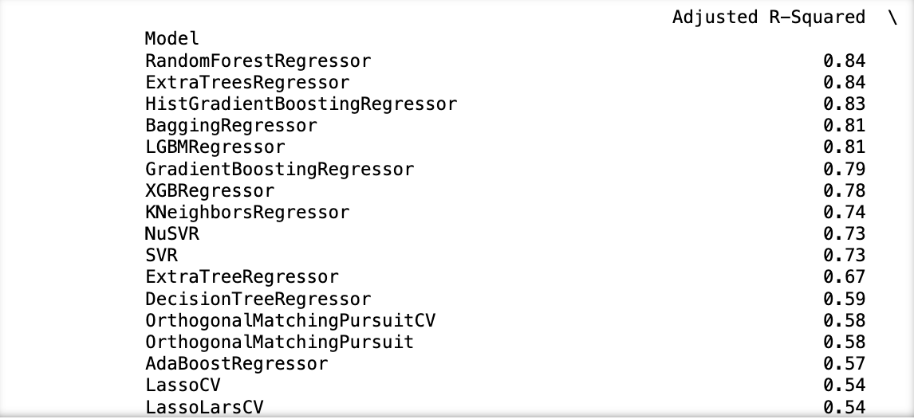
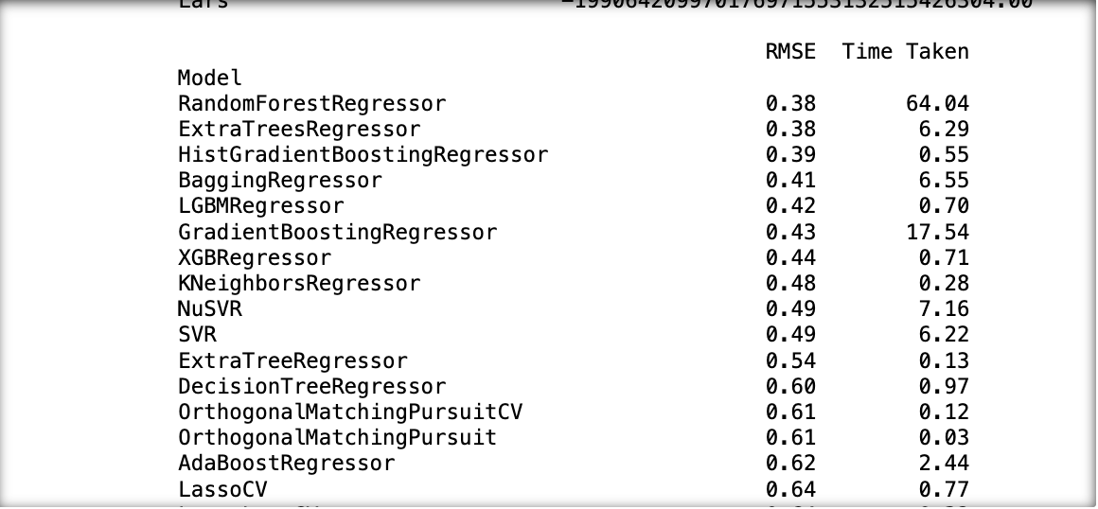
DATA IMPUTATION – LazyRegressor
Used LazyRegressor to find out which is the best model to use for imputing missing values
The best fit was RandomForestRegressor but the time taken for imputing is considerably large. Hence, we use the second best fit - ExtraTreesRegressor

Slide 10
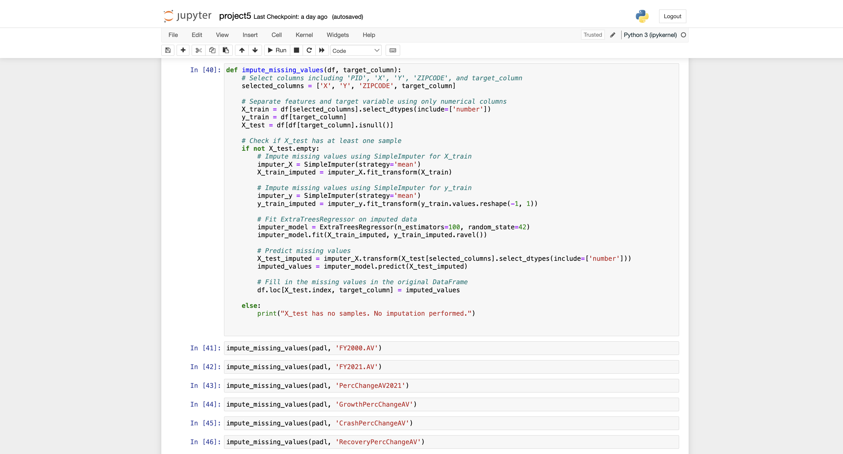
DATA IMPUTATION – ExtraTreesRegressor
Used ExtraTreesRegressor to impute missing values.
It uses a decision tree model to impute by keeping the property, coordinates zip code, unique Property_IDs, etc as features and column with missing values as target column
We created a function so that we can use it to impute values in any column we want.

Slide 11
DATABASE MODEL
Crime_table
padl
Neighborhood
INCIDENT_NUMBER
OFFENSE_CODE
…...
Neighborhood
PID
…...
Blue Bike Stations
Neighborhood
X
Y
Number
…..
survey_grouped table
merged_df table
Neighborhood
Avg_Age_Range
Highest_Gender_Dem
Rent
Accomodation_Cost_Satisfaction
Mode_of_Transportation
Public_Transportation_Options_Satisfaction
Transportation_Cost
Neighborhood
PID_min
PID_max
ZIPCODE_min
ZIPCODE_max
FY2021.AV_mean
DiffAV2021_mean
PercChangeAV2021_mean
RecoveryDiffAV_mean
RecoveryPercChangeAV_mean
...
Observation_Count
Acres
SqMiles
geometry
fatalities
bike_stations_count
robbery
drug
assault
Shootings
Data enrichment
crash_records
Neighborhood
date_time
mode_type
…....
propvalues_FY23
Neighborhood
rent_cnt
…....

Slide 12
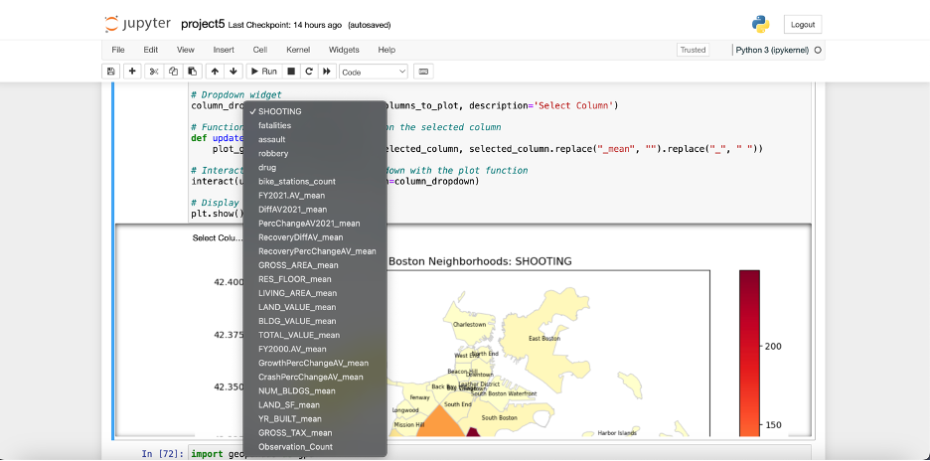
DATA VISUALIZATION – Dropdown Menu using ipywidgets
For property values final dataset:
Created a dropdown menu to show plots for whichever parameter selected using ipywidgets.

Slide 13
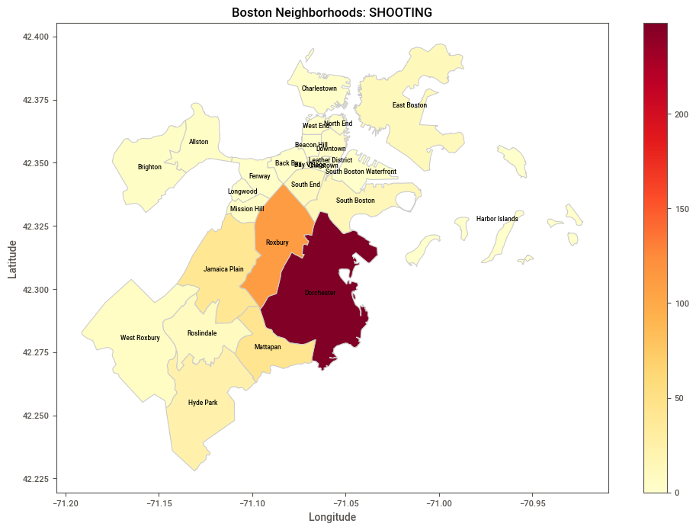
DATA VISUALIZATION – Geopandas, Shapely, Matplotlib
For property values and characteristics, crime statistics, blue bike stations distribution and road accidents - Neighborhood level analysis:
Created heat maps by creating a function that plots graphs of all applicable columns and shows them based on the column chosen in dropdown menu

Slide 14
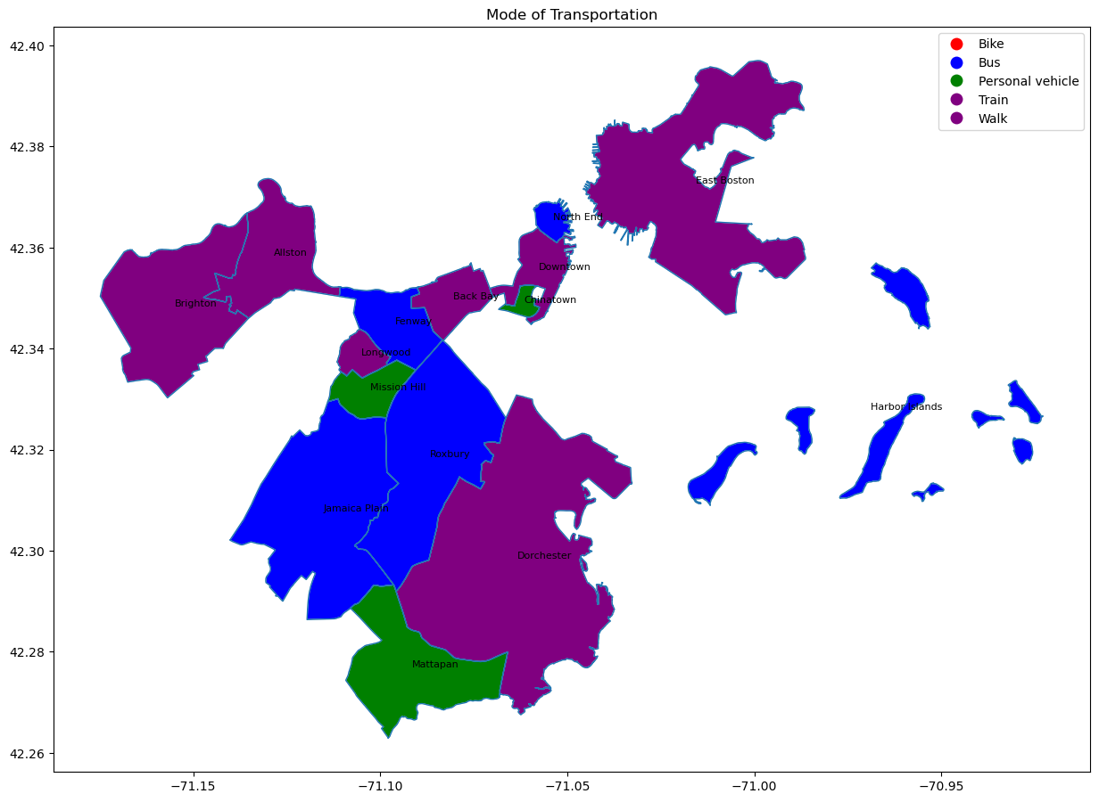
DATA VISUALIZATION – Geopandas, Shapely, Matplotlib
Used matplotlib.colors to plot final survey dataset
Used ListedColormap since there was categorical data

Slide 15
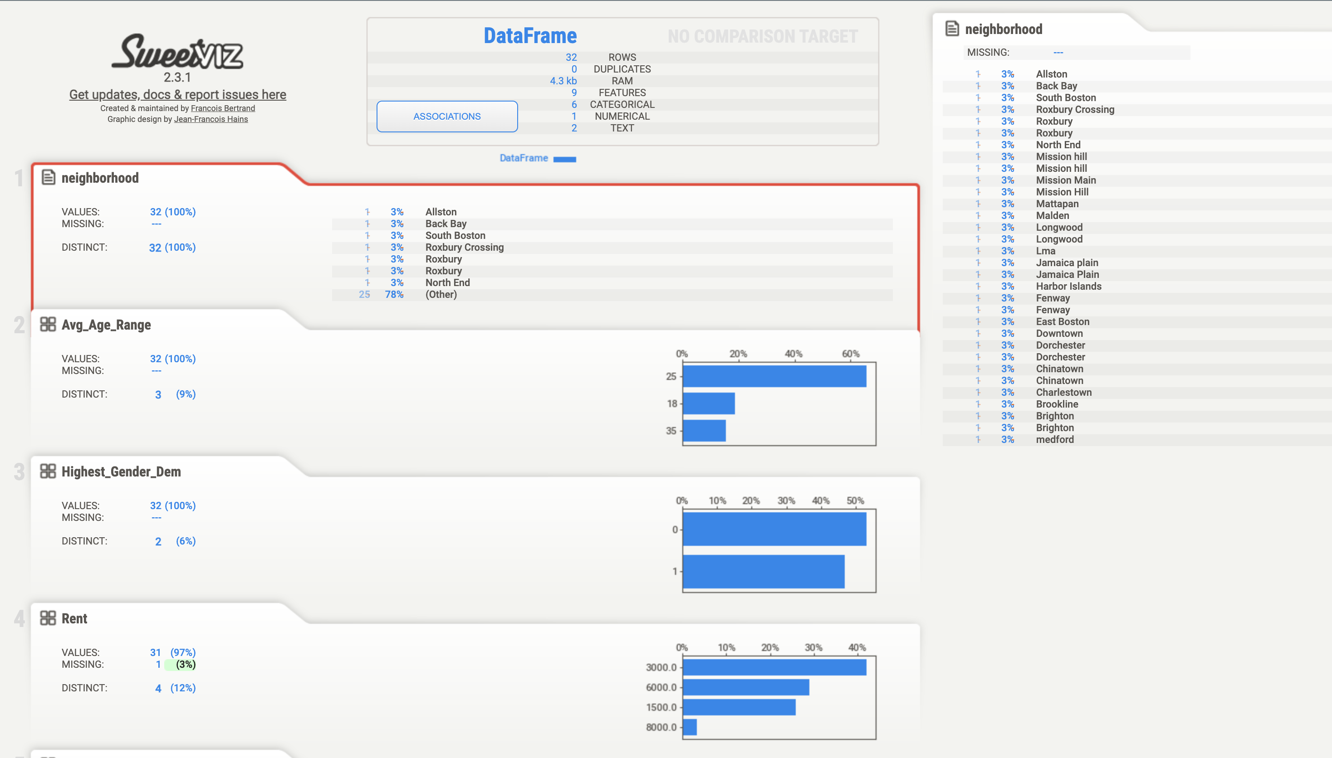
DATA Profiling - Sweetviz
Used sweetviz for creating a data profiling report on survey_grouped_report

Slide 16
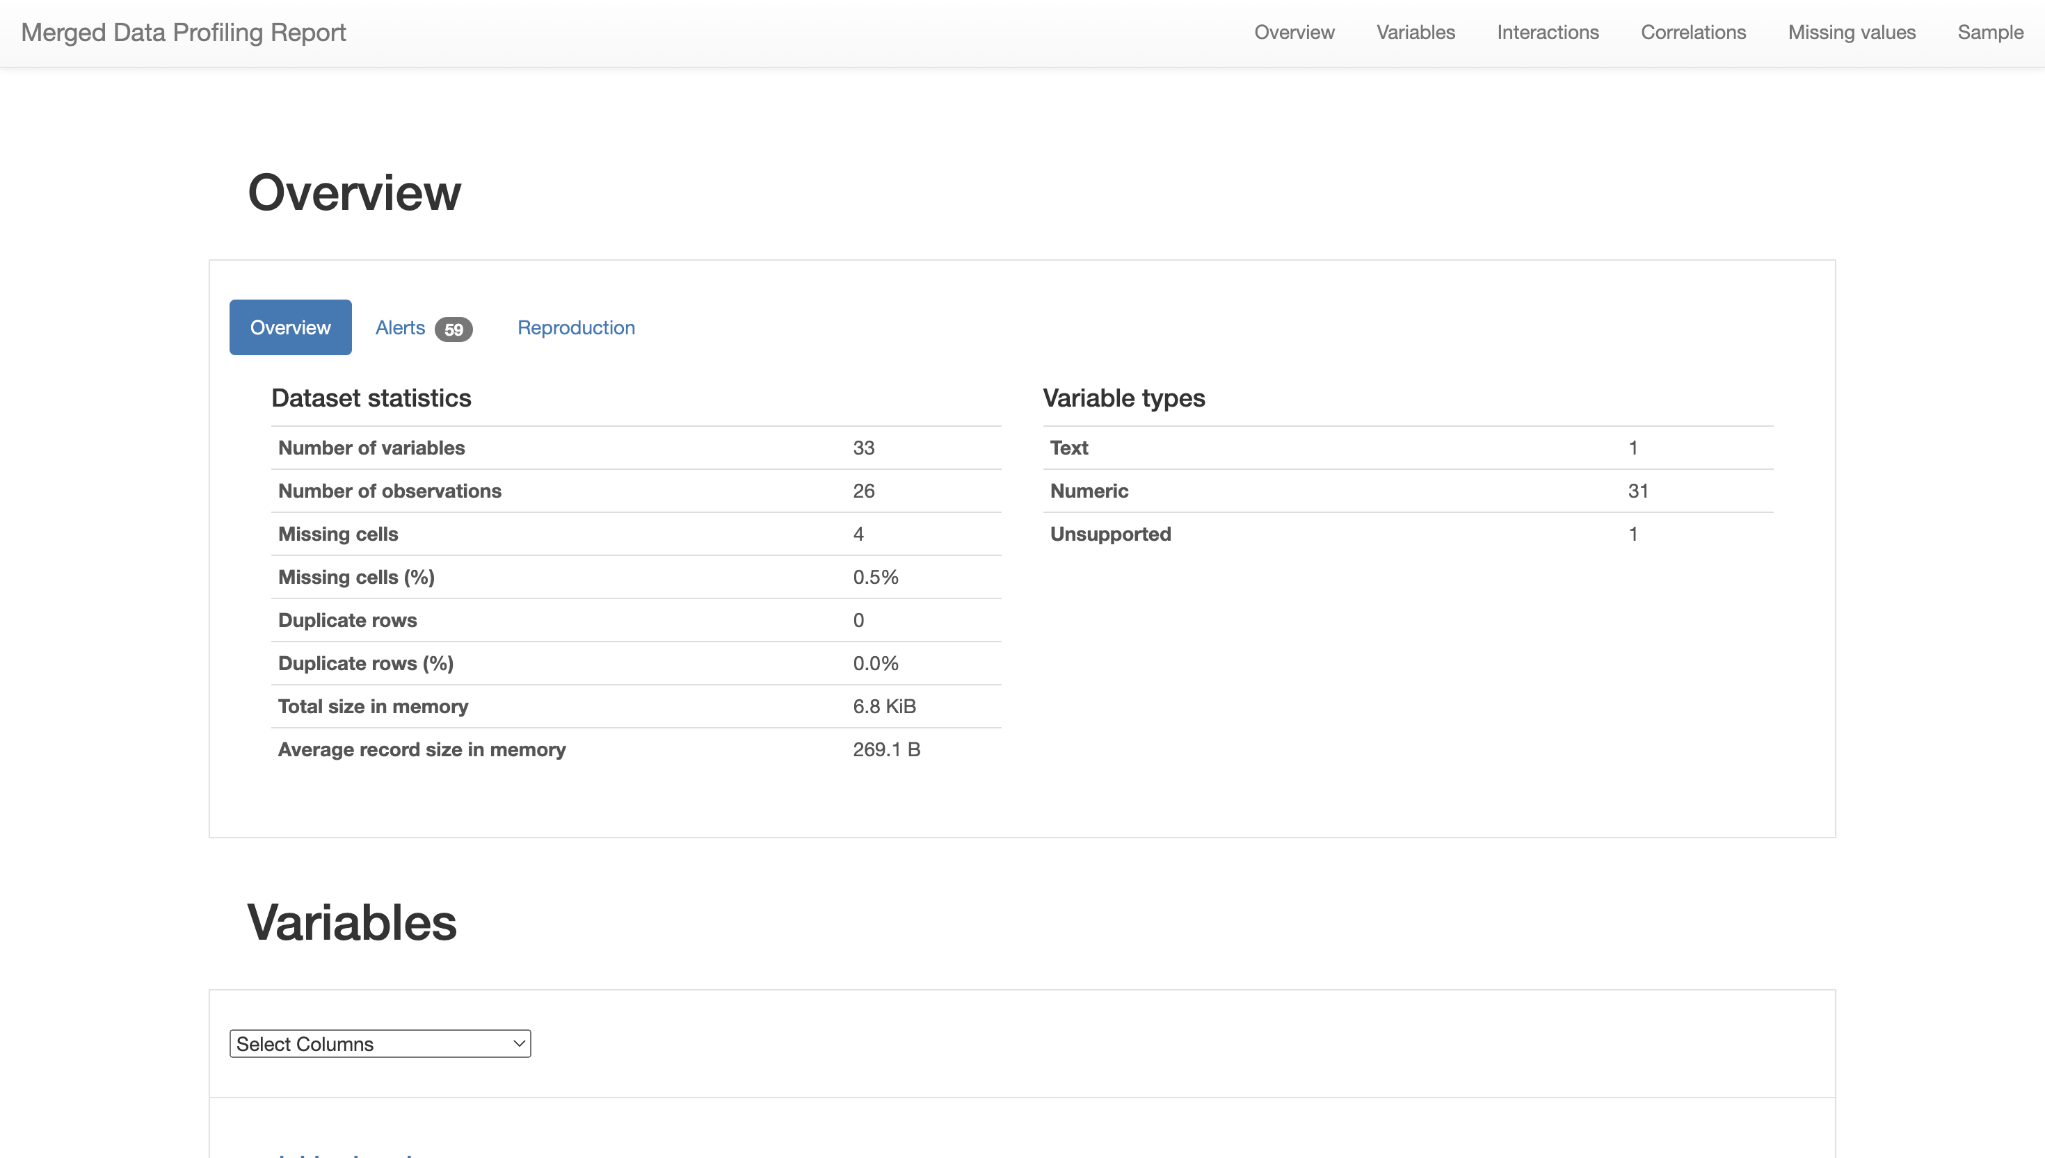
DATA Profiling - ydata_profiling
Used ydata_profiling for creating a data profiling report on merged property and neighborhood characteristics

Slide 17



DATA ANALYSIS
Used feature engineering, LazyRregressor and ExtraTreesRegressor for imputation and visualizing
Inferences drawn from heat maps showing different values on a neighborhood analysis level
Challenges
Information Quality
Data Sufficiency
Data Accuracy
Data merging, as we had to get the boundaries for all neighborhoods in Boston and assign neighborhoods to all individual properties using their coordinates

Slide 18

IMPROVEMENT IF THEIR WAS MORE TIME
If there was more time, data that have not been found with respect to neighborhoods could have been added via other datasets or scraping.
The Tools could have been merged as a plotly-dash and streamlit web-app. We have successfully launched the website locally but had problems while committing them online to the streamline website using GitHub repositories
Machine Learning tools could have been utilized for predicting future property values if we had enough computing power

